Slide 1
A simple led controller
Take a behind-the-scenes look at the brand new Arduino powered wifi led controller x9000!

Slide 2
How’s it made?

Slide 3
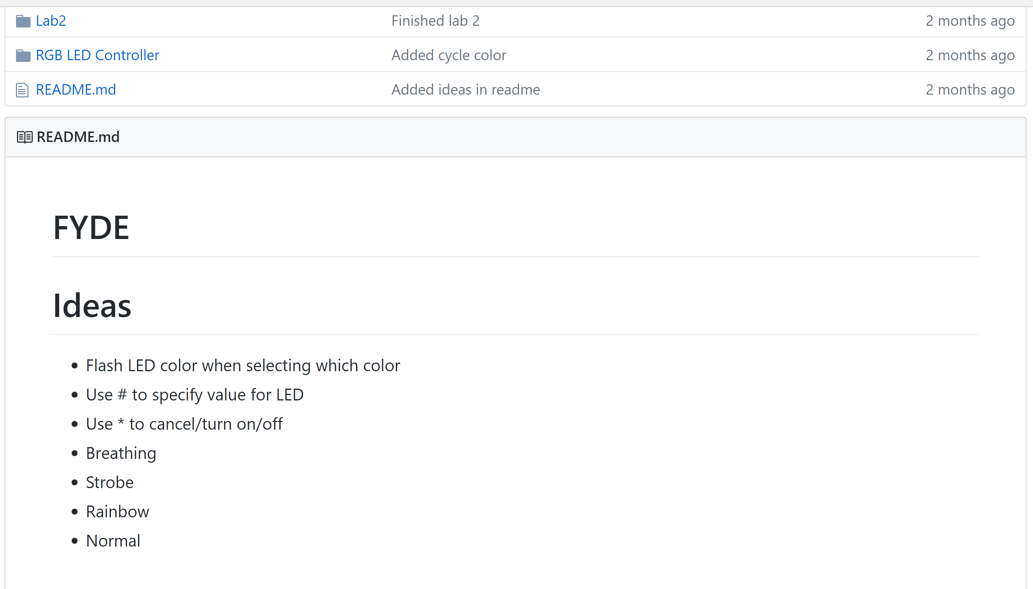
How it’s made
Brainstorming

Slide 4

How it’s made
Teamwork

Slide 5
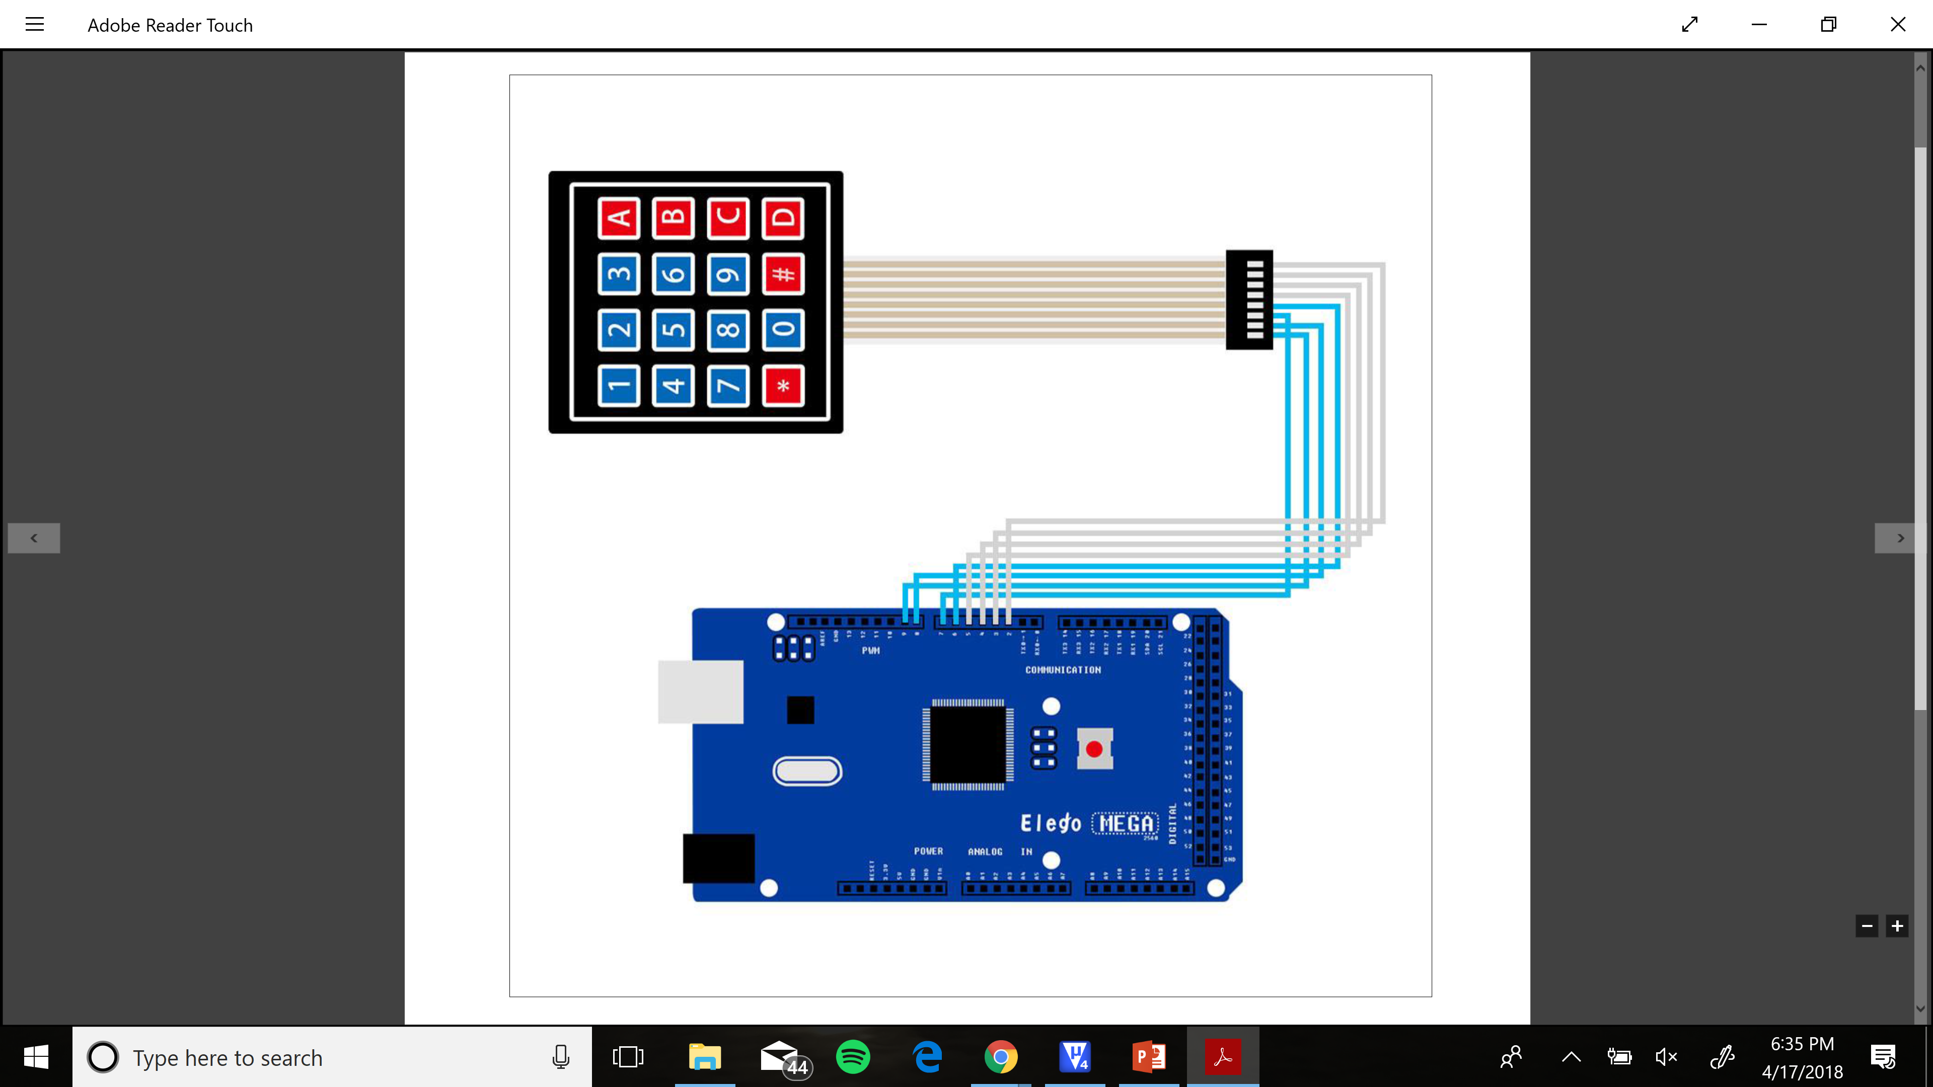
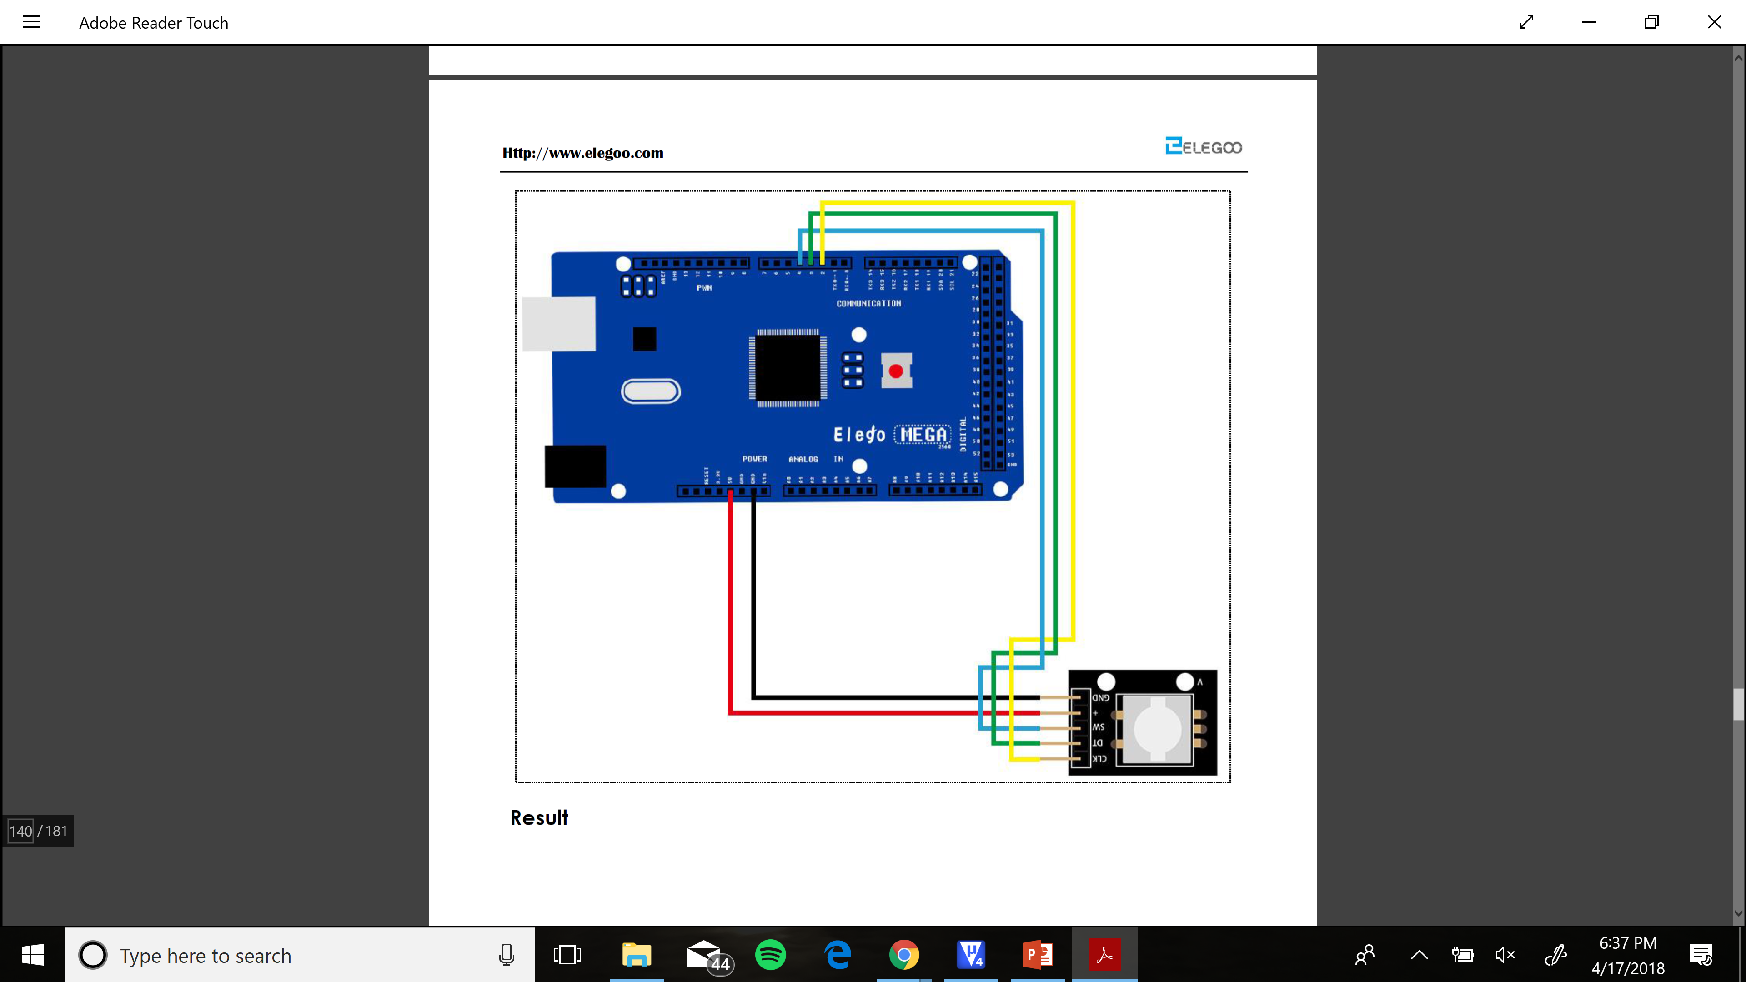
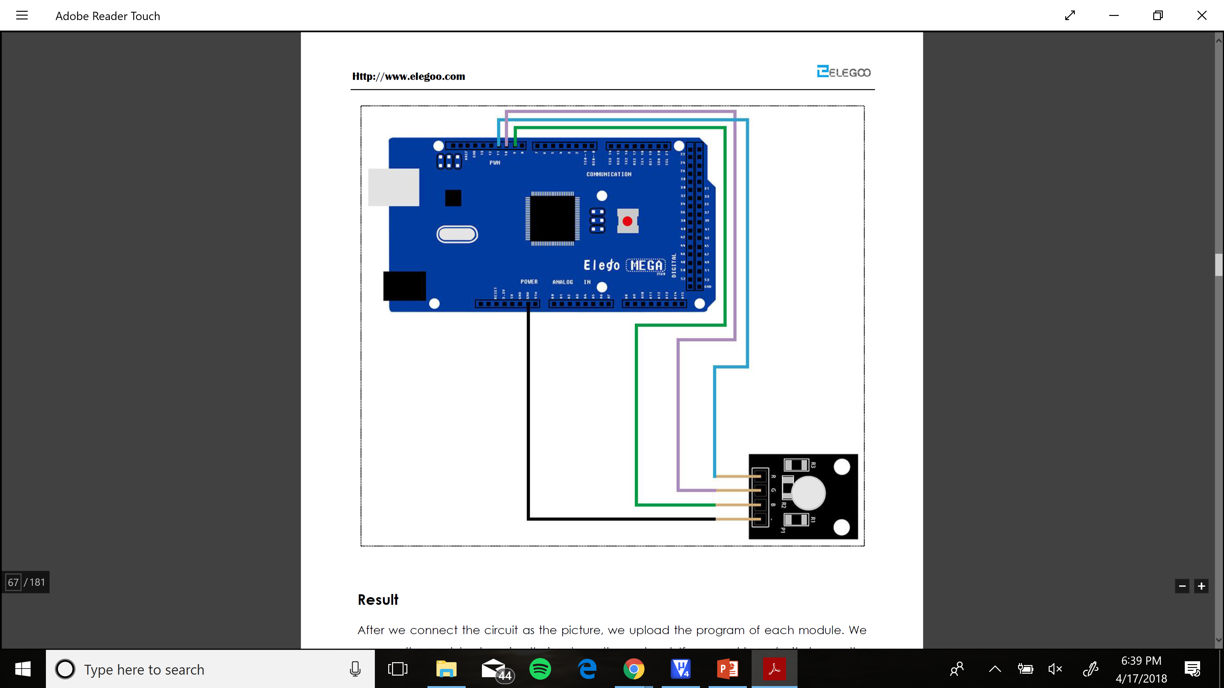
How it’s made
Sensors and Actuators:
Button Module Rotary Encoder Module RGB LED

Slide 6
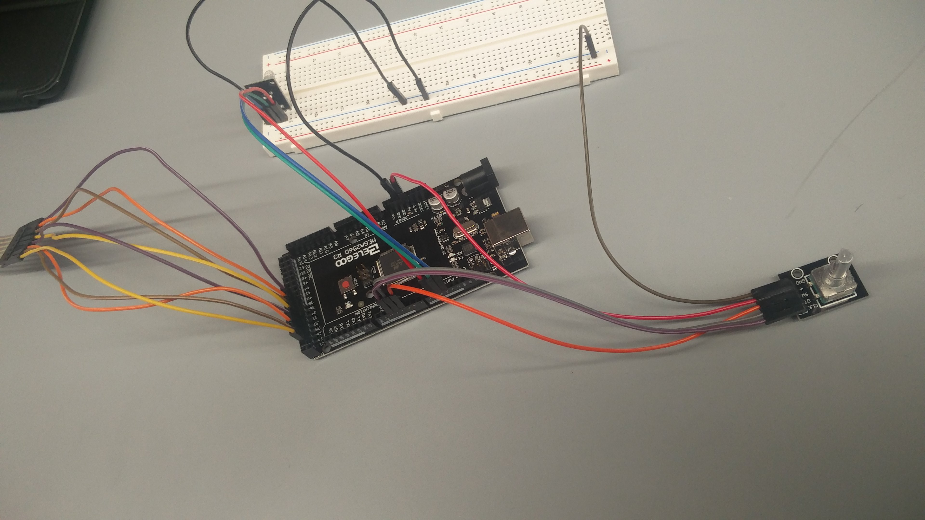
Put it all together:

